Slide 1
K means clustering

Slide 2
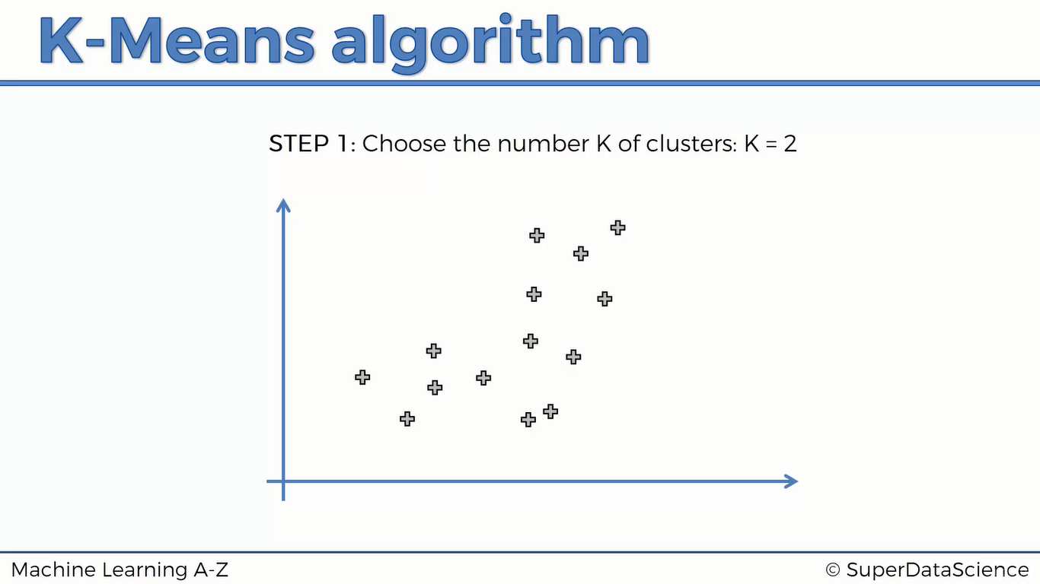

Slide 3
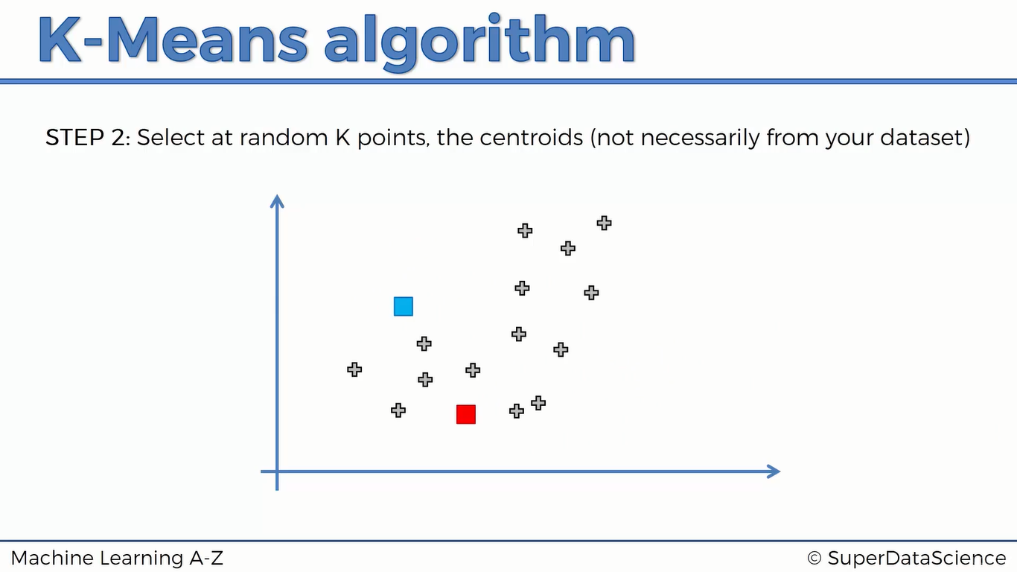

Slide 4
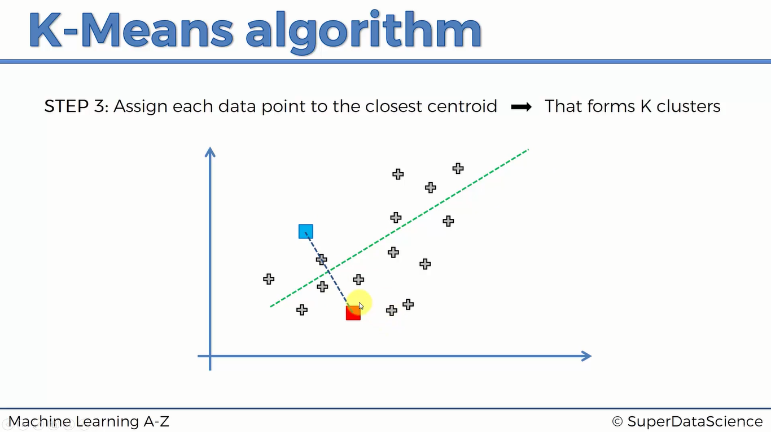

Slide 5
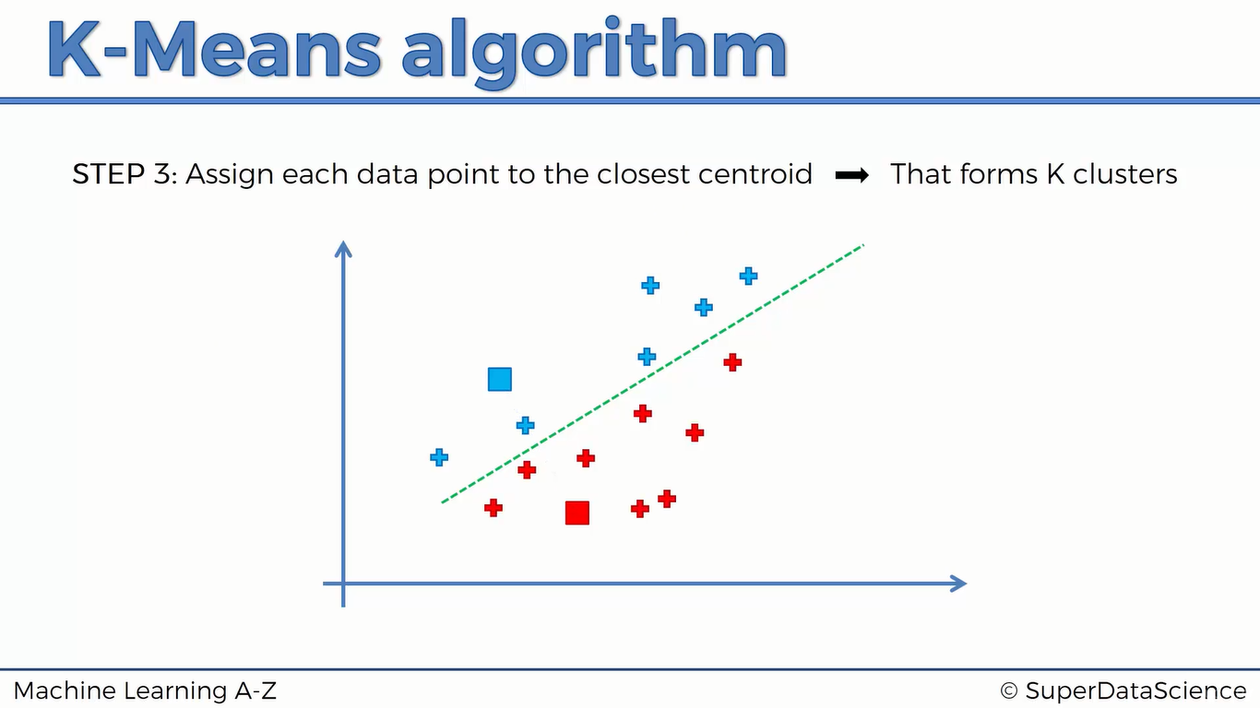

Slide 6
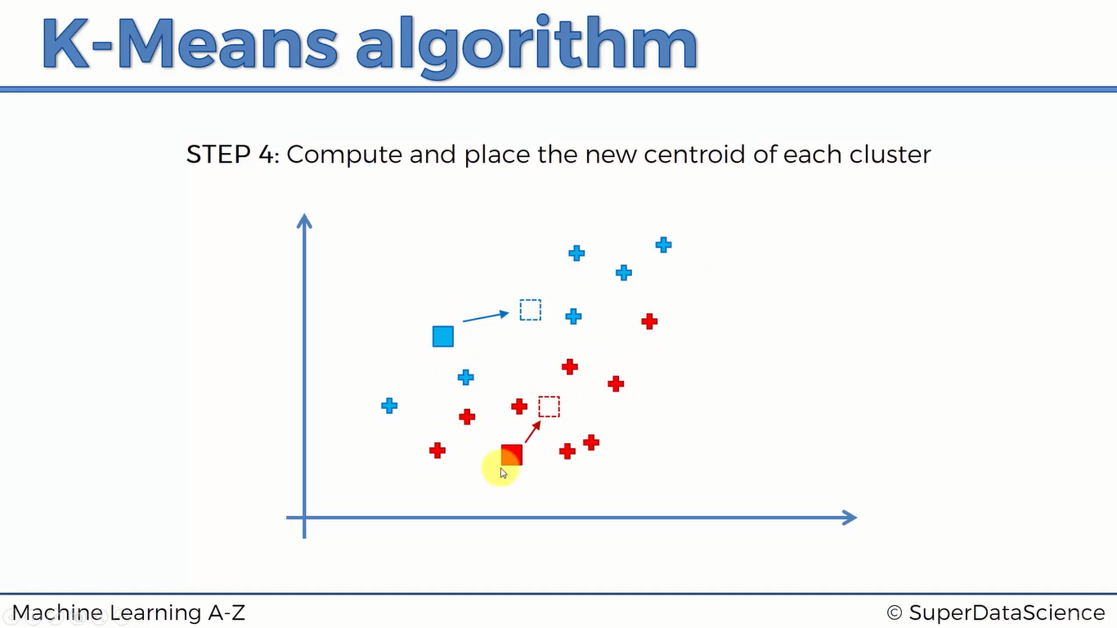

Slide 7
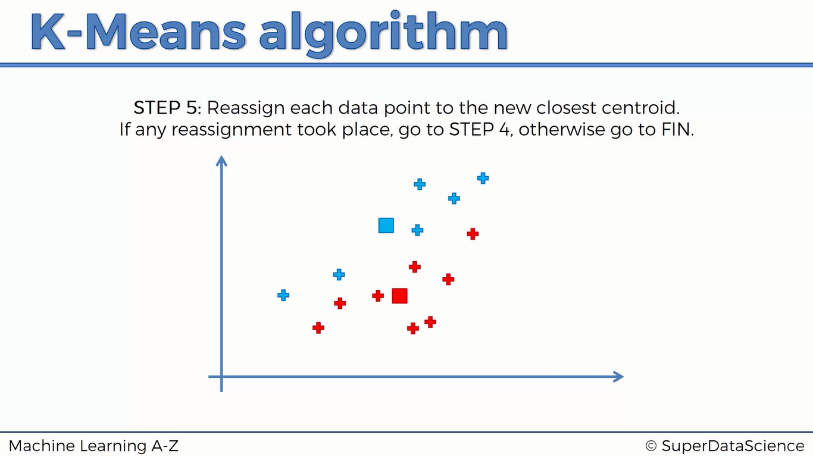

Slide 8
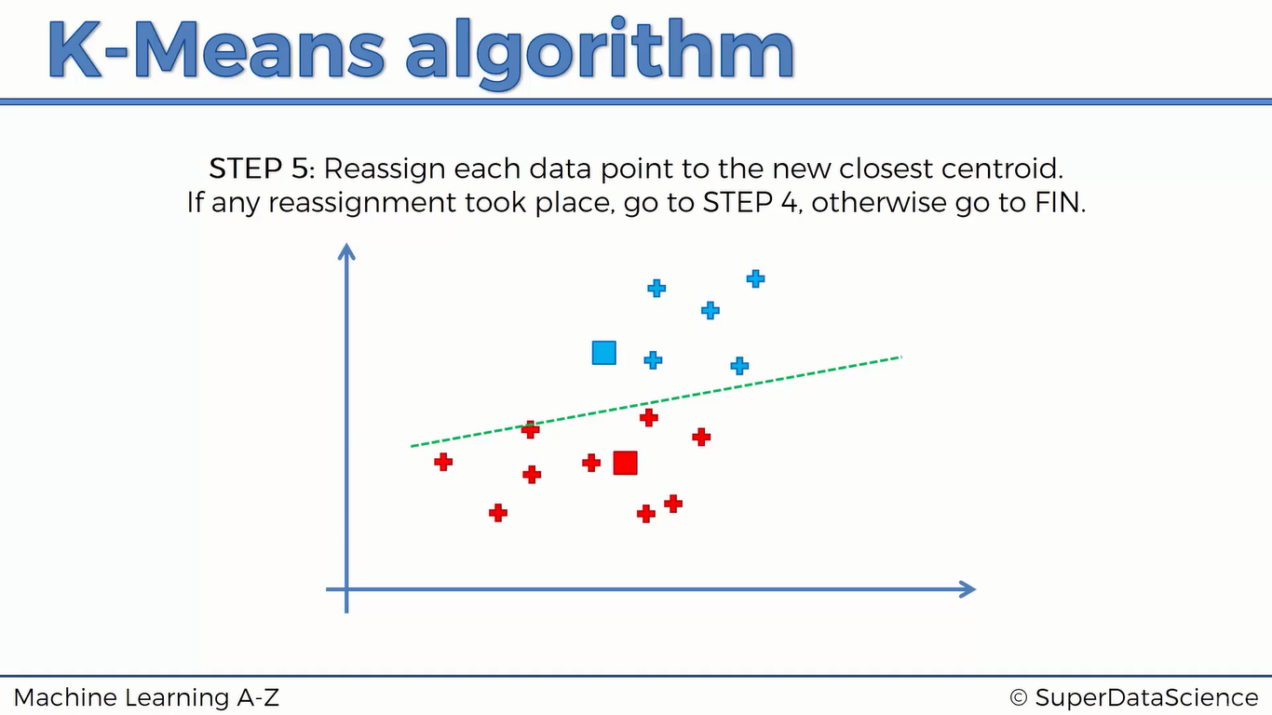

Slide 9
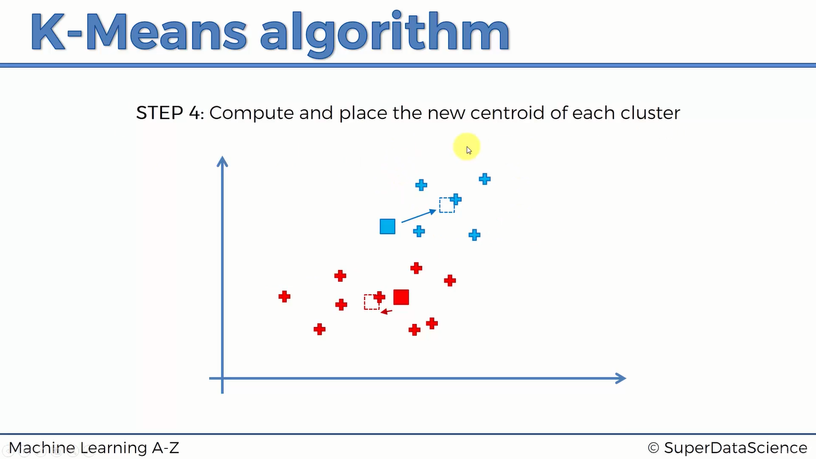

Slide 10
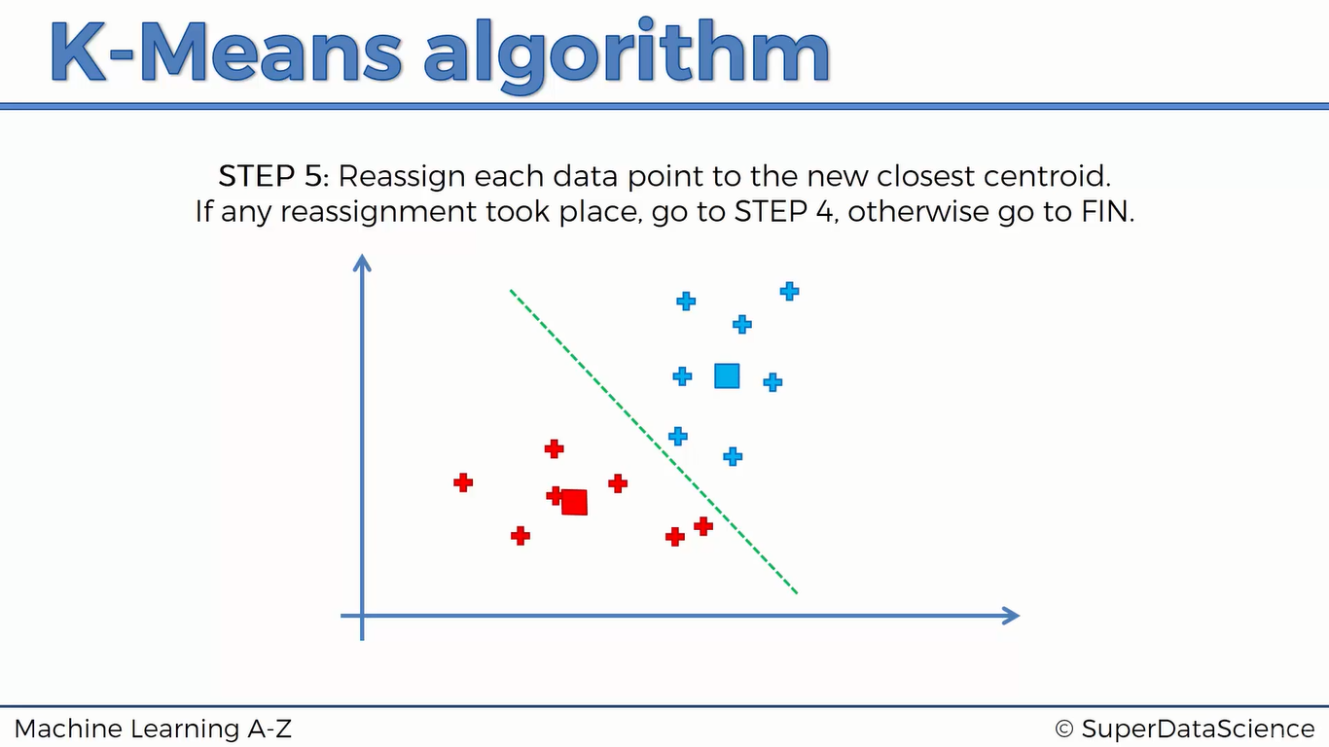

Slide 11
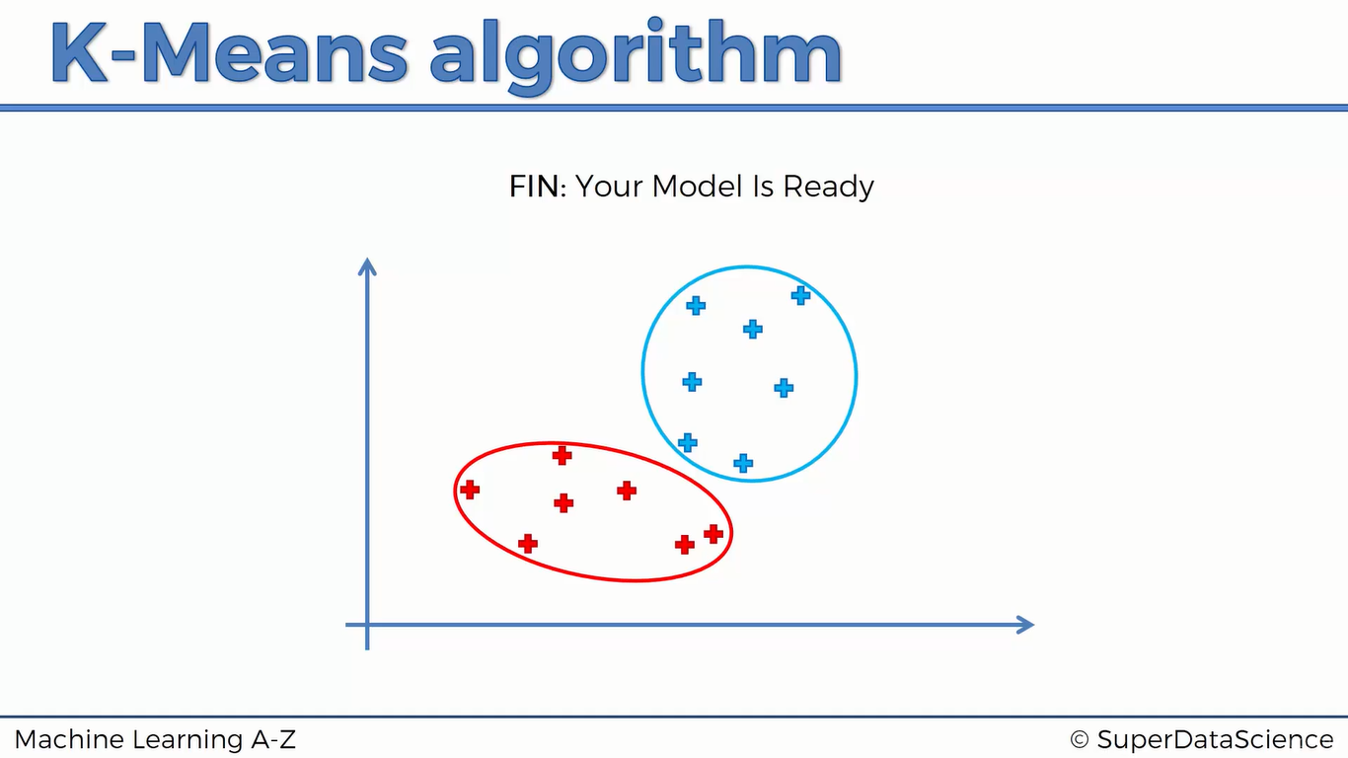

Slide 12
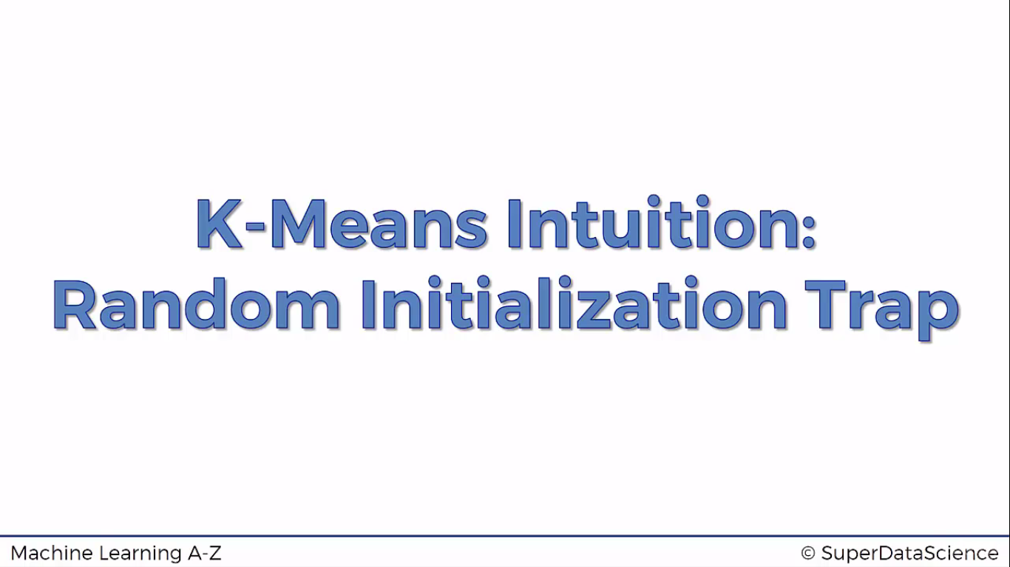

Slide 13
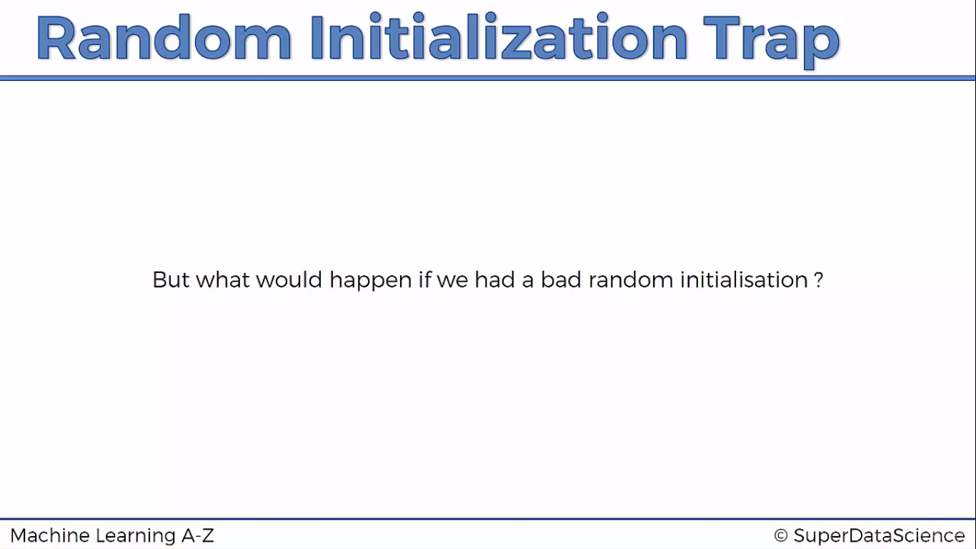

Slide 14
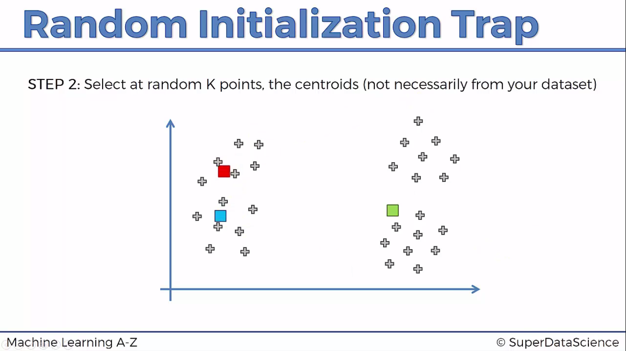

Slide 15
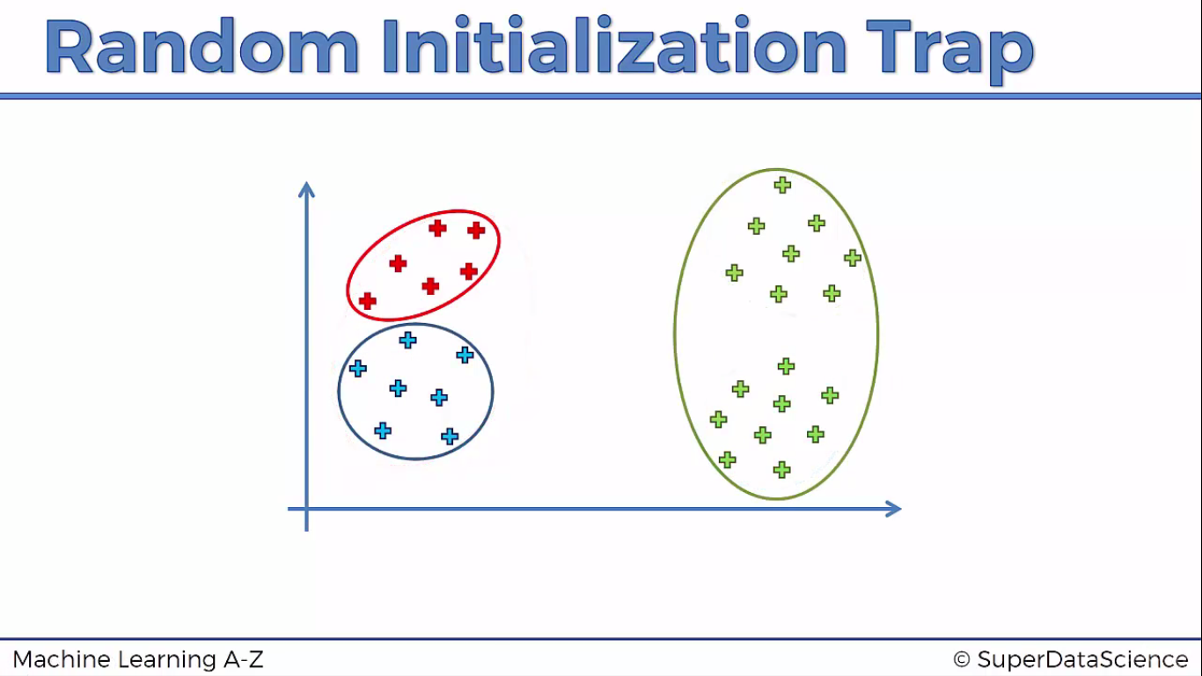
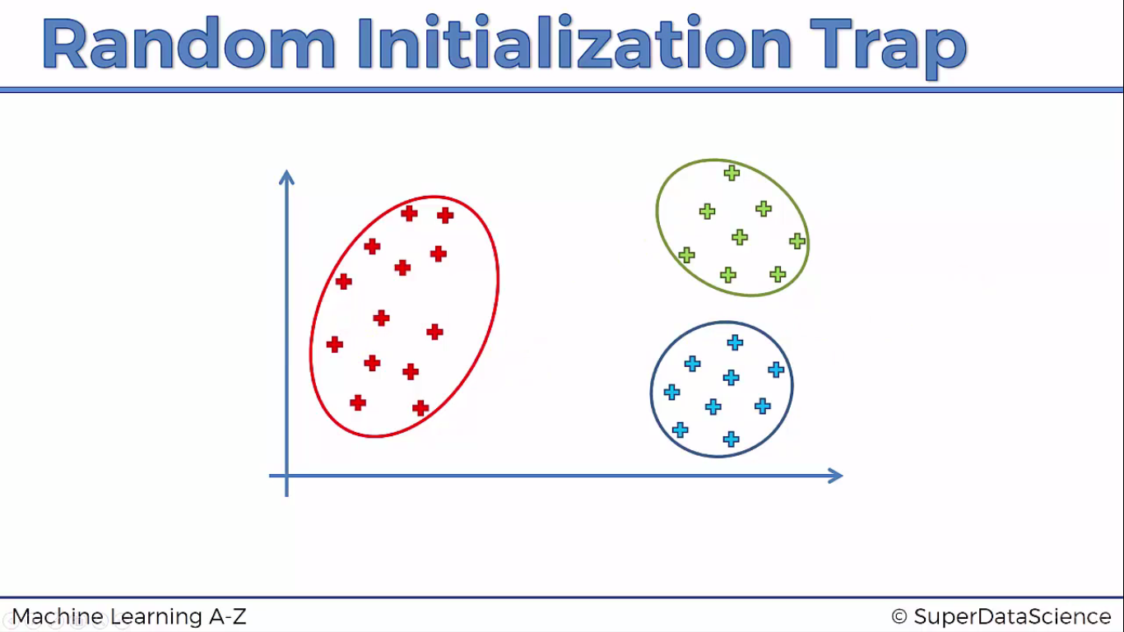

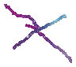
Wrong clustering due to random centroid selection
Original clustering

Slide 16
Choosing the value of K
We consider the WCSS score with different values of K starting from 1 to say 10.
The value at elbow of cruve will be optimum

Slide 17
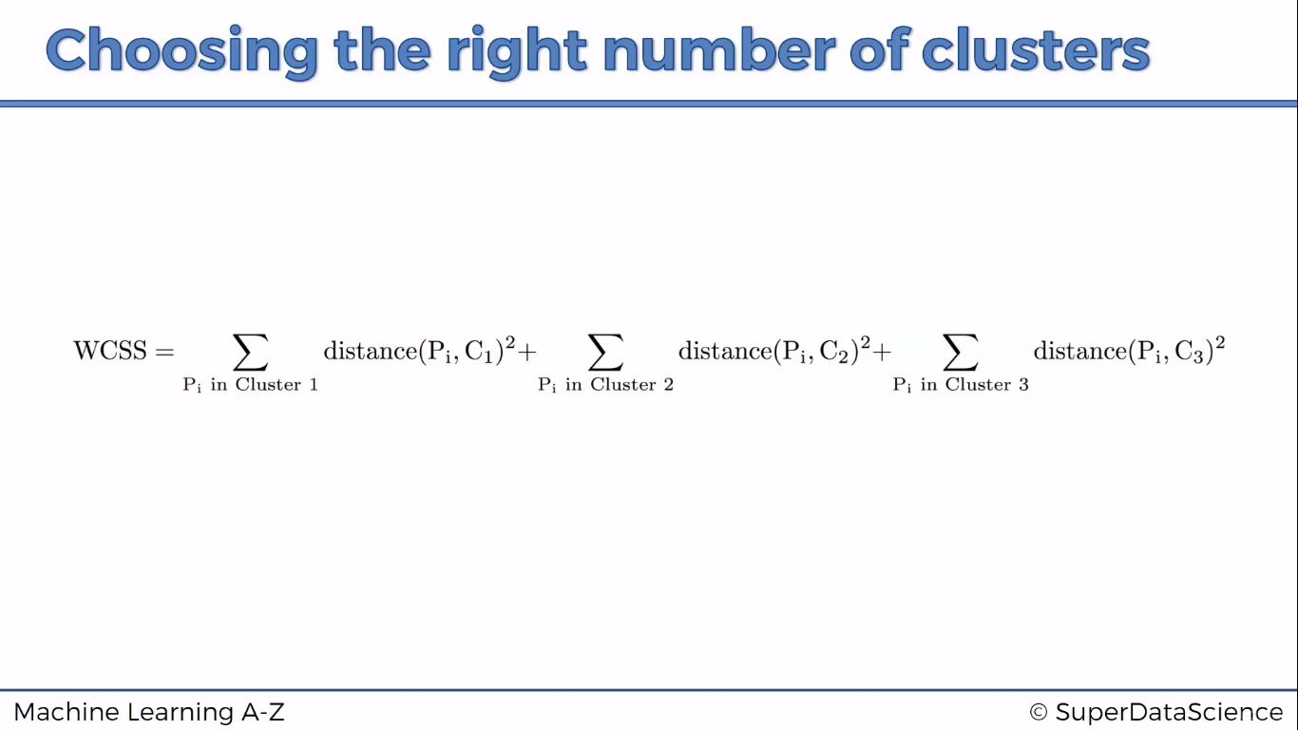

Slide 18
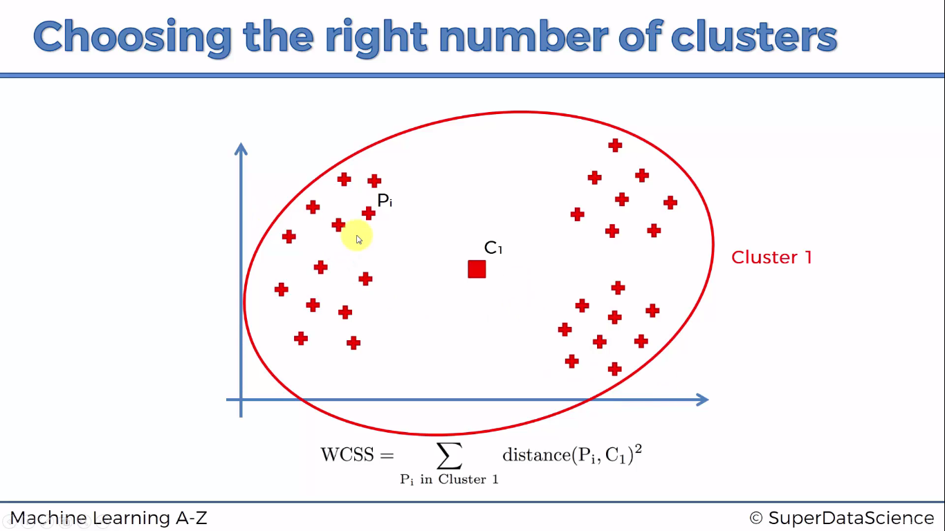

Slide 19
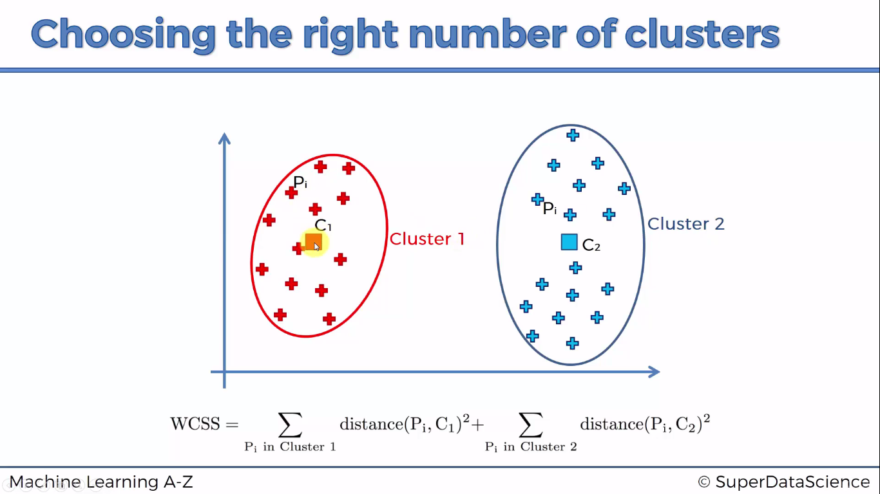

Slide 20
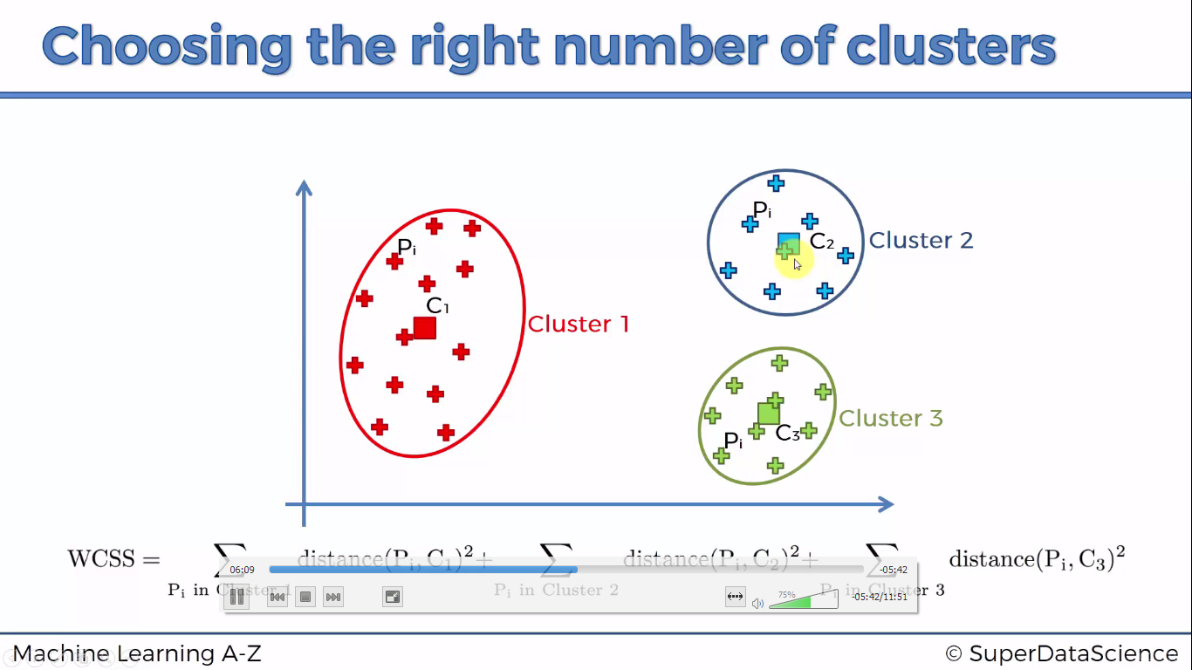

Slide 21
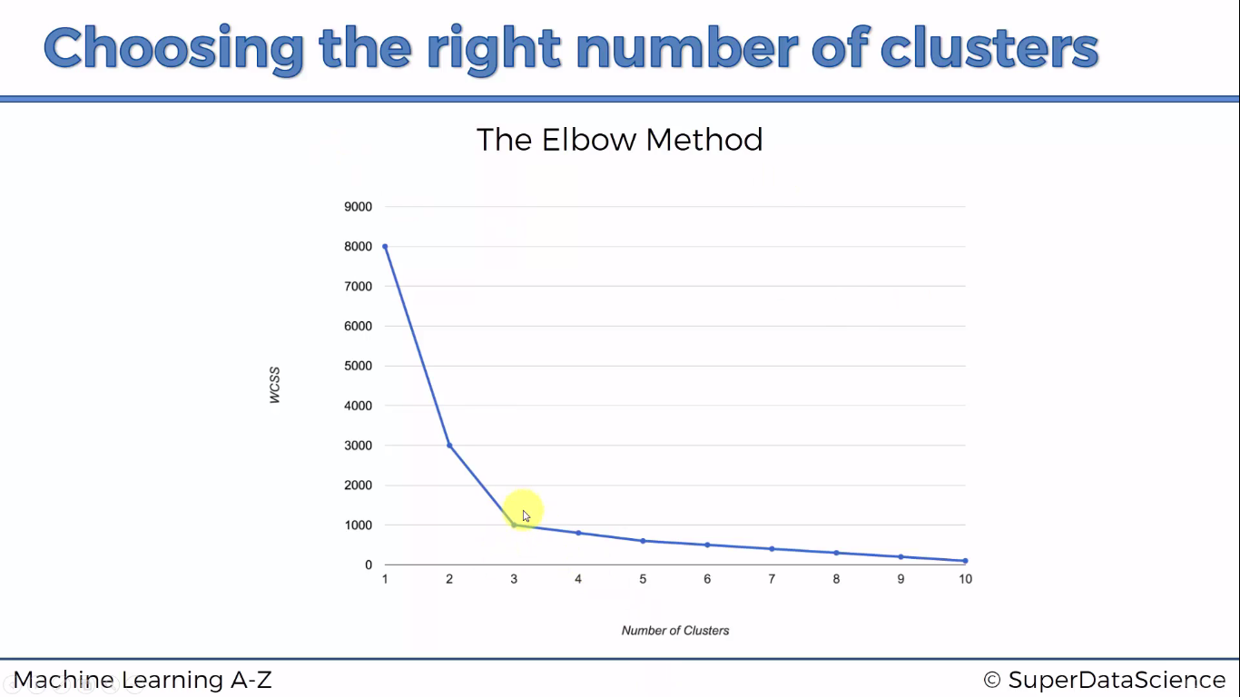

Slide 22
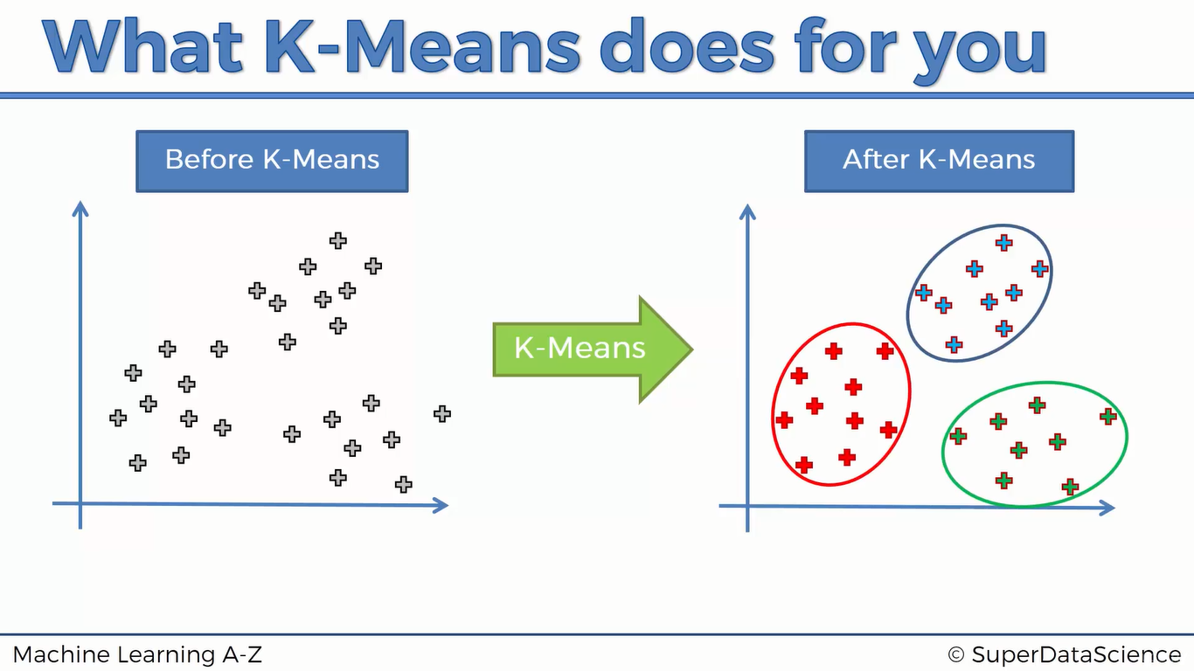

Slide 23

Python

Slide 24
Import librarires
import pandas as pd
import numpy as np
import matplotlib.pyplot as plt

Slide 25
Import dataset
dataset = pd.read_csv("D:/machine learning AZ/Machine Learning A-Z Template Folder/Part 4 - Clustering/Section 24 - K-Means Clustering/K_Means/Mall_Customers.csv")
X = dataset.iloc[:,[3,4]].values

Slide 26
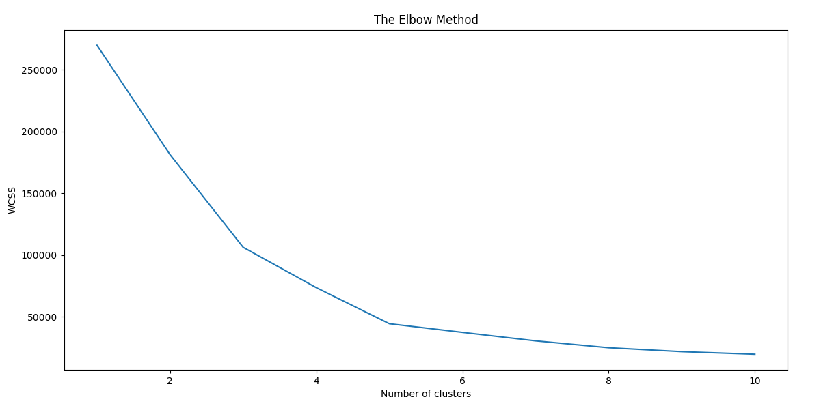
K means
from sklearn.cluster import Kmeans
wcss = []
for i in range(1,11):
kmeans = KMeans(n_clusters=i, init='k-means++', n_init=10, max_iter=300)
kmeans.fit(X)
wcss.append(kmeans.inertia_)
plt.plot(range(1,11),wcss)
plt.title('The Elbow Method')
plt.xlabel('Number of clusters')
plt.ylabel('WCSS')
plt.show()

Slide 27
Run k means again with elbow value of k
kmeans = KMeans(n_clusters=5, init='k-means++', n_init=10, max_iter=300)

Slide 28
predictions
y_kmeans = kmeans.fit_predict(X)

Slide 29
graph
# Visualising the clusters
plt.scatter(X[y_kmeans == 0, 0], X[y_kmeans == 0, 1], s = 100, c = 'red', label = 'Cluster 1')
plt.scatter(X[y_kmeans == 1, 0], X[y_kmeans == 1, 1], s = 100, c = 'blue', label = 'Cluster 2')
plt.scatter(X[y_kmeans == 2, 0], X[y_kmeans == 2, 1], s = 100, c = 'green', label = 'Cluster 3')
plt.scatter(X[y_kmeans == 3, 0], X[y_kmeans == 3, 1], s = 100, c = 'cyan', label = 'Cluster 4')
plt.scatter(X[y_kmeans == 4, 0], X[y_kmeans == 4, 1], s = 100, c = 'magenta', label = 'Cluster 5')
plt.scatter(kmeans.cluster_centers_[:, 0], kmeans.cluster_centers_[:, 1], s = 300, c = 'yellow', label = 'Centroids')
plt.title('Clusters of customers')
plt.xlabel('Annual Income (k$)')
plt.ylabel('Spending Score (1-100)')
plt.legend()
plt.show()

Slide 30
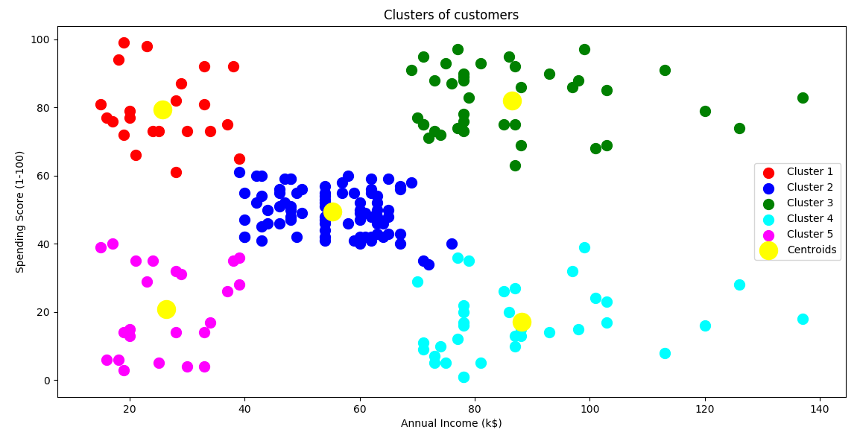

Slide 31

R

Slide 32
Importing dataset
library(readr)
dataset <- read_csv("D:/machine learning AZ/Machine Learning A-Z Template Folder/Part 4 - Clustering/Section 24 - K-Means Clustering/K_Means/Mall_Customers.csv")
dataset = dataset[4:5]

Slide 33
Wcss plot
set.seed(6)
wcss = vector()
for (i in 1:10) wcss[i] = sum(kmeans(dataset, i)$withinss)
plot(1:10,
wcss,
type = 'b',
main = paste('The Elbow Method'),
xlab = 'Number of clusters',
ylab = 'WCSS')

Slide 34
Running k means with correct k
set.seed(29)
kmeans = kmeans(x = dataset, centers = 5)
y_kmeans = kmeans$cluster

Slide 35
plotting
# Visualising the clusters
library(cluster)
clusplot(dataset,
y_kmeans,
lines = 0,
shade = TRUE,
color = TRUE,
labels = 2,
plotchar = FALSE,
span = TRUE,
main = paste('Clusters of customers'),
xlab = 'Annual Income',
ylab = 'Spending Score')

